Slide 1
BU419
Capital Markets and Regulation

Slide 2
Capital Market Risk Financing
Insurance companies will use risk financing methods, such as reinsurance to smooth claims losses, cashflows and for capital relief
Alternative methods of risk financing have emerged to provide capital, funding for losses, catastrophes in particular
Capital market products are traded financial instruments with maturities > 1 year

Slide 3
Insurance Linked Securities (ILS)
An ILS is a financial instrument whose value is primarily driven by loss events
Marketable security; value based on cash flows that arise from the transfer of insurable risks
Provides investors with diversification as they constitute a distinct asset class with risk that normally has low correlation with that of other asset classes

Slide 4
ILS – Generic Securitization Model

Slide 5
Example of Insurance-Linked Security
A property insurer has hurricane concentration risk in the southeastern and Gulf Coast regions of the United States. The property insurer is financially strong. A Category Three or higher hurricane that affects a densely populated area in the insurer’s coverage region (Dade County, for example) could result in over $1.5 billion in paid insured losses for the firm. The insurer, therefore, wants to use a risk transfer mechanism that will reduce the variability of its financial results from one year to the next due to catastrophic events. It determines that traditional catastrophic reinsurance is not the most economically viable option for doing so, because previous hurricane events reduced reinsurer capacity and increased the year-to-year volatility of the cost of reinsurance.
The property insurer uses an SPV to issue $500 million in three-year catastrophe bonds to, in effect, reinsure its Gulf Coast and southeastern hurricane risks. The bond investors lose interest or interest and principal, depending on the bond series, if a Category Three, Four, or Five hurricane causes insured losses to the property insurer in excess of $1 billion during a twelve-month claims period. The property insurer, in turn, receives reimbursement for any catastrophe losses from the SPV. The bond offering is fully subscribed by investors.
The investors purchase the bonds from the SPV because they provide a premium rate of interest (that is, it is higher than that provided by a United States Treasury bond of comparable maturity) based on the expected frequency and severity of the embedded hurricane risk. In exchange for receiving a premium interest rate, the investors’ return on the bond is linked to the risk of a Category Three or higher hurricane striking during the term of the bond. The bond investors underwrite the hurricane risk, which is an insurable risk because it could also have been underwritten with a traditional reinsurance policy. Therefore, the bond is an insurance-linked security. It is marketable because a secondary financial market exists, which is a market in which a bond can be sold to a subsequent investor during the bond’s term. Therefore, through the process of insurance securitization, the property insurer’s risk of a sizable loss due to a major hurricane has been “securitized” by linking it with the returns provided to investors in a marketable security. The securitization solution enables the property insurer to more effectively deploy its capital resources.
Source: CRM56 Risk Financing 6th Edition, Global Risk Management Institute, Inc.

Slide 6
Catastrophe Bonds
Most common form of an ILS to date
https://www.chicagofed.org/publications/chicago-fed-letter/2018/405

Slide 7
Catastrophe Bonds
Bonds are issued by SPVs developed and owned by large reinsurers, insurers or large corporations to serve as catastrophe bond intermediaries
Can be issued for any type of catastrophic insurable risk, including hurricanes, earthquakes and other adverse weather and environmental risks
Catastrophe losses that trigger payment under a cat bond can be based on aggregate cat losses over a defined period of time or the occurrence of a single catastrophic event

Slide 8
Catastrophe Bonds
Models are used to measure the frequency and severity probabilities that determine the standards used to measure the catastrophic risk embedded in these bonds
Typically structured to provide protection against infrequently occurring (1 in 100 years to 1 in 250 years) events
These frequencies appeal to issuers (they want the bonds to be triggered and priced at a level that reflects infrequency of events) and investors (lower risk of losing money on investment)

Slide 9
Insurance Derivatives
Provide options for insurers that require additional capacity to manage their potential catastrophic losses
Financial contract whose value is based on the level of insurable losses that occur during a specific time period

Slide 10
Insurance Derivatives - Swaps
Insurers can spread risk through swaps
Example: one insurer could exchange portion of cashflows arising from hurricane exposure in a particular geographic area with another insurer’s cash flows arising from tornado exposure in another area
https://documents1.worldbank.org/curated/en/319251467999348409/pdf/97469-BRI-Box391476B-PUBLIC-study-CCRIF-Final.pdf

Slide 11
Insurance Derivatives – Insurance Options
Specialized type of option that derives its value from insurable losses – either an organization’s actual insurable losses or an insurance industry index of losses
https://www.munichre.com/en/solutions/for-industry-clients/adverse-weather.html

Slide 12
Insurance Derivatives – Insurance Options
Example:
Weather options derive their value from a measurement of weather conditions, such as average temperature or cumulative precipitation over a finite period. An organization can purchase these options to transfer weather-related risk.
For example, an Ontario basement repair contractor is most profitable during unusually wet summers—when cracks in basements are most likely to leak. Therefore, the worst-case weather situation for the basement contractor is a prolonged summer drought. The contractor determines that for every inch of precipitation shortfall below average for the months of August and September, the firm loses $10,000 in net income.

Slide 13
Insurance Derivatives – Insurance Options
Example:
The basement repair contractor purchases a weather put option based on the measurement of rainfall during this period at the nearest weather station.
The average precipitation for August through September is seven inches.
The insurance option’s put strike price is set at five inches.
The put option is designed so that for every inch of precipitation below strike value (five inches), the option increases in value by $10,000.
The precipitation cover is written as an insurance policy and has a limit of $40,000.
If the cumulative precipitation between August and September is only three and one-half inches, the contractor will receive a payout of $15,000 [(5–3.5) × 10,000] from the weather insurer to help offset any lost profit from a reduction in the demand for basement repair.

Slide 14
Insurance Derivatives – Insurance Options
Advantages:
Additional risk capacity – alternative to insurance/reinsurance
Lower in cost than ILS (no need for SPV)
Transparent pricing
Standardized or custom contracts
Efficient claims and contract settlements

Slide 15
Insurance Derivatives – Insurance Options
Disadvantages:
Underdeveloped markets
Basis risk (payout from derivative could be much lower or higher than actual losses)
Credit risk/counterparty risks (particularly with swaps)
Regulatory and accounting treatment – potentially offsetting benefits

Slide 16
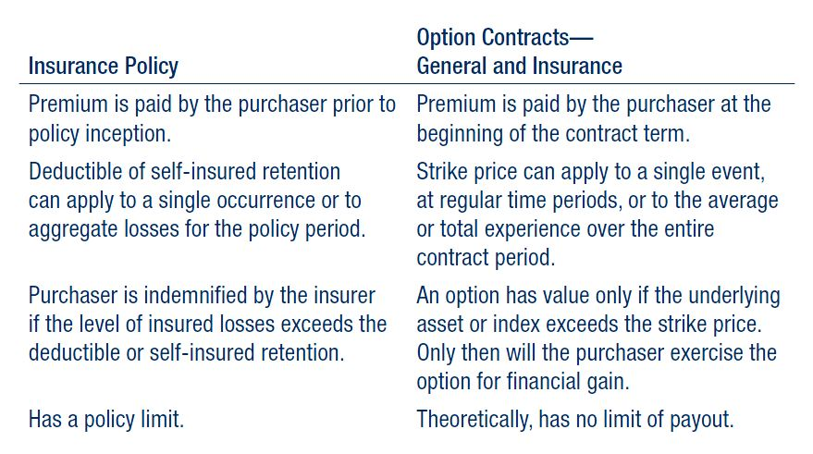
(Re)insurance policies vs Options Contracts

Slide 17
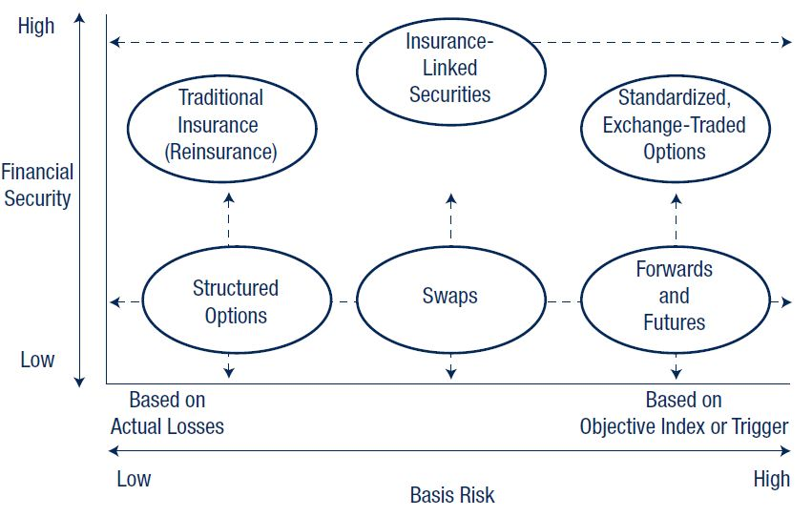
Financial Security and Basis Risk

Slide 18
Regulation
Federal
https://www.osfi-bsif.gc.ca/en/supervision/financial-institutions/property-casualty-insurance-companies
Provincial
https://www.fsrao.ca/industry/property-and-casualty-and-general-insurance
https://ibac.ca/career-development/insurance-industry-regulation/
Advocacy
https://www.ibc.ca/issues-and-advocacy/regulation

Slide 19
Financial Reporting to Regulators
https://www.osfi-bsif.gc.ca/en/data-forms/reporting-returns/filing-financial-returns/financial-reporting-instructions/pc-insurance-return-section-introduction
https://www.fsrao.ca/media/15126/download
https://www.gisa.ca/Documents/View/6206

